Slide 1
Introduction to Algorithms
Asymptotic Notation Θ, O, Ω

Slide 2
Analysis of Algorithm for Time and Space
To analyze an algorithm means:
developing a formula for predicting how fast an algorithm is, based on the size of the input (time complexity), and/or
developing a formula for predicting how much memory an algorithm requires, based on the size of the input (space complexity)
Usually time is our biggest concern
Most algorithms require a fixed amount of space and/or
Memory is not as expensive as time
We can show lower, upper or both bounds for time or space requirements of a given algorithm using Asymptotic Notation

Slide 3
Problem Size Matters in Calculating Time or Space Complexity
Time and Space complexity will depend on the Problem Size, why?
If we are searching an array, the “size” of the input array could decide who long it will take to go through the entire array
If we are merging two arrays, the “size” could be the sum of the two array sizes
If we are computing the n^{th} Fibonacci number, or the n^{th} factorial, the “size” is n
We choose the “size” to be a parameter that determines the actual time (or space) required
It is usually obvious what this parameter is
Sometimes we need two or more parameters (think of an example)

Slide 4
Characteristic Operation
In computing time complexity, one good approach is to count characteristic operations
What a “characteristic operation” is depends on the particular problem
If searching, it might be comparing two values
If sorting an array, it might be:
comparing two values
swapping the contents of two array locations
both of the above
Sometimes we just look at “how many times the innermost loop is executed?”

Slide 5
How many times innermost loop will execute?
Algorithm Array_Sum(A):
for i := 0 to n-1 do
sum := sum + A[i]
return sum;
Algorithm Array2D_Sum(A):
for i := 0 to n-1 do
for j := 0 to n-1 do
sum := sum + A[i][j]
return sum;

Slide 6
Sequential Search Analysis
Input: An array A storing n items, target x
Output: true if x is in A, false otherwise
Algorithm Sequential_Search(A, x):
for i := 0 to n-1 do
if (A[i] = x)
return true;
return false;
Identify “Characteristic Operations” in this code?
How many times will the loop actually execute?
that depends on “how many times comparison operations are require to execute?”

Slide 7
Exact vs Simplified Analysis
It is sometimes possible, in assembly language, to compute exact time and space requirements
We know exactly how many bytes and how many cycles each machine instruction takes
For a problem with a known sequence of steps (factorial, Fibonacci), we can determine how many instructions of each type are required
However, often the exact sequence of steps cannot be known in advance
The steps required to sort an array depend on the actual numbers in the array (which we do not know in advance)

Slide 8
Exact vs Simplified Analysis
In a higher-level language (such as Java), we do not know how long each operation takes
Which is faster, x < 10 or x <= 9 ?
We don’t know exactly what the compiler does with this
The compiler almost certainly optimizes the test anyway (replacing the slower version with the faster one)
In a higher-level language we cannot do an exact analysis
Our timing analyses will use major oversimplifications
Nevertheless, we can get some very useful results

Slide 9
Average, Best or Worst Case
Usually we would like to find the average time to perform an algorithm
However,
Sometimes the “average” isn’t well defined
Example: Sorting an “average” array
Time typically depends on how out of order the array is
How out of order is the “average” unsorted array?
Sometimes finding the average is too difficult
Often we have to be satisfied with finding the worst (longest) time required
Sometimes this is even what we want (say, for time-critical operations)
The best (fastest) case is seldom of interest

Slide 10
Sequential Search Analysis – Best and Worst Cases
Input: An array A storing n items, target x
Output: true if x is in A, false otherwise
Algorithm Sequential_Search(A, x):
for i := 0 to n-1 do
if (A[i] = x)
return true;
return false;
Value of x is found at the first index in an array i.e. A[0] → Best Case, required only 1 comparison/iteration
Value of x is found at the last index in an array i.e. A[n-1] → Worst Case, require n comparison/iteration
Worse Case Time Complexity: k*n + c
N is Problem Size i.e. Array Size
k time taken for loop execution (increment i, check if i < N-1) and comparison
c is time taken for loop init and return
Best Case Time Complexity: k*1 + c
This is nothing but a special case of worst case equation

Slide 11
More Examples
Algorithm Is_Array_Sorted(A):
for i := 0 to n-1 do
if A[i] > A[i+1]
return false
return true;
Best Case → __________________?
Worst Case → __________________?
Algorithm Swap(x, y):
temp := x
x := y
y := temp
Best Case → __________________?
Worst Case → __________________?

Slide 12
More Examples
Algorithm Array2D_Sum(A):
for i := 0 to n-1 do
for j := 0 to n-1 do
sum := sum + A[i][j]
return sum;
Algorithm Array2D_Sum():
for i := 0 to n-1 do
for j := 0 to n-1 do
A[i][j] := i*j
for i := 0 to n-1 do
for j := 0 to n-1 do
sum := sum + A[i][j]
return sum;

Slide 13
What is the time complexity of these Algorithms?
Algorithm Array_Sum(A):
for i := 0 to n-1 do
sum := sum + A[i]
return sum;
f(n) = k * n + c
n – problem size
k – time taken for incrementing i, check i<=n-1 and sum=sum+A[i]
c – time take for initialization and return
Algorithm Array2D_Sum(A):
for i := 0 to n-1 do
for j := 0 to n-1 do
sum := sum + A[i][j]
return sum;
f(n) = k*n*n+c = k*n²+c
n – problem size
k – time taken for incrementing i, check i<=n-1 and sum=sum+A[i][j]
c – time take for initialization and return

Slide 14
Algorithm Analysis
Represent Algorithm Analysis (i.e. Runtime) as function of input n i.e. f(n) e.g. For Sequential Search f(n) = k*n + c
what we care about: orders of growth
Ex: 0.5n² and 700n² are no different!
when input size doubles, the running time quadruples
constant factors do NOT matter

Slide 15
Constant Factors are Ignored, Why?
Algo1: f1(n) = 5n²
Algo2: f2(n) = n²
f1(n)/f2(n) = 5n²/ n² = 5
If we double the data size i.e. n = 2n
f1(2n)/f2(2n) = 5(2n²)/ (2n²) = 10n²/ 2n² = 5
Algo: f(n) = kn²+c
As n → ∞, c becomes less and less dominating
Therefore, n² is the dominating factor.

Slide 16
Only Highest Order Term Matters
We don't need to study algorithms when we want to sort two elements, because different algorithms make no difference
we care about algorithm performance when the input size n is very large
Ex: n² and n² + n + 2 are no different, because when n is really large, n + 2 is negligible compared to n²
only the highest-order term matters

Slide 17
Only Highest Order Term Matters
f1(n) = n², f2(n) = n²+n+10
With n=10
f1(10) = (100) and
f2(10) = (100 + 10 + 10) = 120
Difference of 16.67%
With n = 50000
f1(50000) = (2,500,000,000) and
f2(50000) = (2,500,000,000 + 50000 + 10) = 2,500,050,010 ≅ 2,500,000,000
Difference of 0.002%

Slide 18
What is the time complexity ?
Algorithm IncreasingLoop(A):
for i := 1 to n step 2*i do
// do something
Algorithm DecresingLoop(A):
for i := n to 1 step –i/2 do
// do something

Slide 19
What is the time complexity?
Algorithm Algo1():
for i := 0 to n-1 do
// do something
for j := 0 to m-1 do
// do something
Algorithm Algo2():
for i := 0 to n-1 do
for j := 1 to n step j*2 do
sum := sum + A[i][j]
return sum;

Slide 20
Big O notation – Simplifying f(n)
Throwing out the constants is one of two things we do in analysis of algorithms
By throwing out constants, we simplify 12n² + 35 to just n²
Our timing formula is a polynomial, and may have terms of various orders (constant, linear, quadratic, cubic, etc.)
We usually discard all but the highest-order term
We simplify n² + 3n + 5 to just n²
We call this a Big O notation

Slide 21
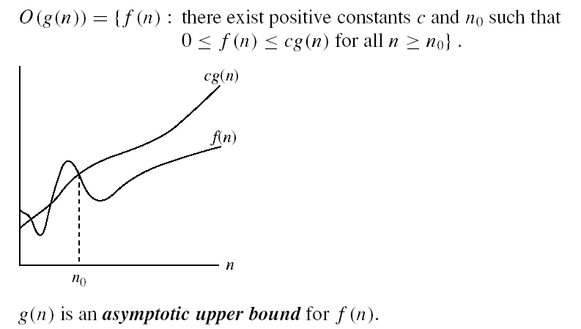
Asymptotic Notation
f(n) ∈ O(g(n))
Usually written as
f(n) = O(g(n)) or
f(n) is O(g(n))

Slide 22
Can we Justify Asymptotic Notation?
Consider f(n) = n² + 3n + 5 as n varies:
n = 0 n² = 0 3n = 0 f(n) = 5
n = 10 n² = 100 3n = 30 f(n) = 135
n = 100 n² = 10000 3n = 300 f(n) = 10,305
n = 1000 n² = 1000000 3n = 3000 f(n) = 1,003,005
n = 10,000 n² = 10⁸ 3n = 3*10⁴ f(n) = 100,030,005
n = 100,000 n² = 10¹⁰ 3n = 3*10⁵ f(n) = 10,000,300,005
Here, f(n) = n² + 3n + 5 and g(n) = n²(higher order term), what will be the values of c and n0 for f(n) = O(g(n)) = cg(n) to be true?

Slide 23
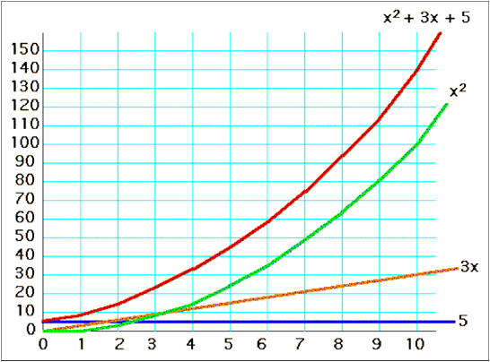
f(n) = x² + 3x + 5, for x=1..10
Brute Force method:
c=2, n=0 → f(n)=5, cg(n)=0
C=2, n=1 → f(n)=9, cg(n)=2
C=2, n=2 → f(n)=15, cg(n)=8
c=2, n=3 → f(n)=23, cg(n)=18
C=2, n=4 → f(n)=33, cg(n)=32
C=2, n=5 → f(n)=45, cg(n)=50
C=2, n=6 → f(n)=59, cg(n)=72 . . .

Slide 24
Common time complexities
BETTER
WORSE
O(1) constant time
O(log n) log time
O(n) linear time
O(n log n) log linear time
O(n²) quadratic time
O(n³) cubic time
O(n^{k}) polynomial time
O(2^{n}) exponential time

Slide 25
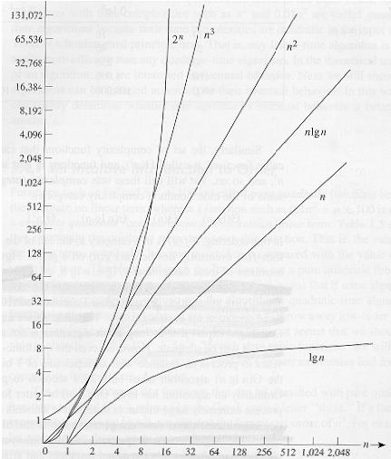
Common Time Complexities

Slide 26
Big O Visual - O(g(n)) is the set of functions with larger or same order of growth as f(n)
O(NlogN)
20NlogN+3N+100
NlogN+100N
100NlogN-0.5N-20
O(N²)
5N² +3N+100
15N² +100
N² + 100NlogN-20
O(N)
3N+100
100N
0.5N-20
O(N³)
5N³ +3N+100
23N³ + 5N² +100N
N³ + 100NlogN-20
O(1)
100
5
0.5

Slide 27
Algorithm Examples for Time Complexity
Big O Notation | Name | Example(s)
O(1) | Constant | # Odd or Even number, # Swapping two numbers
O(log n) | Logarithmic | # Finding element on sorted array with binary search
O(n) | Linear | # Find max element in unsorted array, # Duplicate elements in array with Hash Map
O(n log n) | Linearithmic | # Sorting elements in array with merge sort
O(n²) | Quadratic | # Duplicate elements in array **(naïve)**, # Sorting array with bubble sort
O(n³) | Cubic | # 3 variables equation solver
O(2^{n}) | Exponential | # Find all subsets
O(n!) | Factorial | # Find all permutations of a given set/string

Slide 28
Examples:
2n² = O(n³): 2n² ≤ cn³ ⇒ 2 ≤ cn ⇒ c = 1 and n₀= 2
n² = O(n²): n² ≤ cn² ⇒ c ≥ 1 ⇒ c = 1 and n₀= 1
1000n² + 1000n = O(n²): 1000n² + 1000n ≤ 1000n² + 1000n² ⇒ 1000n² + 1000n ≤ 2000n² ⇒ c=2000 and n₀ = 1
1000n² – 1000n = O(n²): 1000n² – 1000n ≤ 1000n² – 1000n² ? We cannot solve this therefore, the solution will have to be changed 1000n² – 1000n = O(n²): ⇒ 1000n² – 1000n ≤ 1000n² ⇒ c=1000 and n₀ = 1
n = O(n²): n ≤ cn² ⇒ cn ≥ 1 ⇒ c = 1 and n₀= 1

Slide 29
More Examples
Show that 30n + 8 is O(n).
Show ∃c,n₀: 30n + 8 ≤ cn, ∀n ≥ n₀ .
Let c=31, n₀ = 8. Then cn = 31n = 30n + n ≥ 30n + 8, so 30n + 8 ≤ cn

Slide 30
Big-O example, graphically
Note 30n + 8 isn’t less than n anywhere (n>0).
It isn’t even less than 31n everywhere.
But it is less than 31n everywhere to the right of n=8.
cn = 31n
30n+8
30n+8 ∈O(n)
Value of function →
n
n ≥ n₀=8 →
Increasing n →

Slide 31
No Uniqueness
There is no unique set of values for n₀ and c in proving the asymptotic bounds
Prove that 100n + 5 = O(n²)
100n + 5 ≤ 100n² + 5 = 100n ≤ 100n²
for all n ≥ 1
n₀ = 1 and c = 100 is a solution
100n + 5 ≤ 100n + 5n = 105n ≤ 105n² for all n ≥ 1
n₀ = 1 and c = 105 is also a solution
Must find SOME constants c and n₀ that satisfy the asymptotic notation relation

Slide 32
Exercise
n² + 3n + 5 = O(n²): Find c and n₀
n² + 3n + 5 <= n² + 3n² + 5 ⇒ n² + 3n + 5 <= 4n² + 5 ⇒ c=4 and n₀=1
Which of the below Big O notation is correct. If correct then try to find c and n0 values.
n⁴ + 100n² + 10n + 50 = O(n³)
10n³ + 2n² = O(n³)
n³ - n² = O(n⁴)
nlogn+ n² = O(nlogn)
10 = O(n)
1273 = O(1)

Slide 33
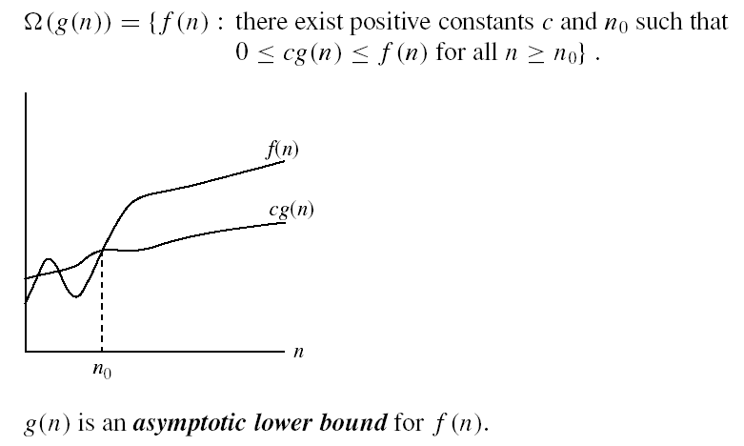
Big Ω (Omega)
Ω(g(n)) is the set of functions with larger or same order of growth as g(n)

Slide 34
Examples
5n² = Ω(n)
∃ c, n₀ such that: 0 ≤ cn ≤ 5n² ⇒ cn ≤ 5n² ⇒ c = 1 and n₀ = 1
100n + 5 ≠ Ω(n²)
c, n₀ such that: 0 ≤ cn² ≤ 100n + 5
100n + 5 ≤ 100n + 5n (∀ n ≥ 1) = 105n
cn² ≤ 105n ⇒ n(cn – 105) ≤ 0
Since n is positive ⇒ cn – 105 ≤ 0 ⇒ n ≤ 105/c
⇒ contradiction: n cannot be smaller than a constant
n = Ω(2n)
n³ = Ω(n²)
n = Ω(logn)

Slide 35

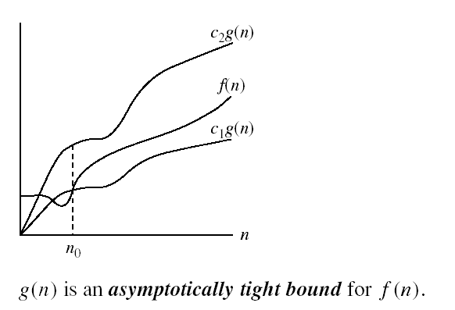
Big Θ (theta)
Θ(g(n)) is the set of functions with the same order of growth as g(n)

Slide 36
Examples
n²/2 –n/2 = Θ(n²)
½ n² - ½ n ≤ ½ n² ∀n ≥ 0 ⇒ c₂= ½
½ n² - ½ n ≥ ½ n² - ½ n * ½ n ( ∀n ≥ 2 ) = ¼ n² ⇒ c₁= ¼
n ≠ Θ(n²): c₁ n² ≤ n ≤ c₂ n²
⇒ only holds for: n ≤ 1/c₁

Slide 37
More Examples
6n³ ≠ Θ(n²): c₁ n² ≤ 6n³ ≤ c₂ n²
⇒ only holds for: n ≤ c₂/6
n ≠ Θ(logn): c₁ logn ≤ n ≤ c₂ logn
⇒ c₂ ≥ n/logn, ∀ n ≥ n₀ – impossible

Slide 38
Asymptotic Notation Sets
O(n)
Ω(n)
Θ(n)

Slide 39
For each of the following pairs of functions, either f(n) is O(g(n)), f(n) is Ω(g(n)), or f(n) = Θ(g(n)). Determine which relationship is correct.
f(n) = log n²; g(n) = log n + 5
f(n) = n; g(n) = log n²
f(n) = log log n; g(n) = log n
f(n) = n; g(n) = log² n
f(n) = n log n + n; g(n) = log n
f(n) = 10; g(n) = log 10
f(n) = 2^{n}; g(n) = 10n²
f(n) = 2^{n}; g(n) = 3^{n}
-> f(n) = Θ (g(n))
-> f(n) = Ω(g(n))
-> f(n) = O(g(n))
-> f(n) = Ω(g(n))
-> f(n) = Ω(g(n))
-> f(n) = Θ(g(n))
-> f(n) = Ω(g(n))
-> f(n) = O(g(n))

Slide 40
Properties
Theorem:
f(n) = Θ(g(n)) ⇔ f = O(g(n)) and f = Ω(g(n))
Transitivity:
f(n) = Θ(g(n)) and g(n) = Θ(h(n)) ⇒ f(n) = Θ(h(n))
Same for O and Ω
Reflexivity:
f(n) = Θ(f(n))
Same for O and Ω
Symmetry:
f(n) = Θ(g(n)) if and only if g(n) = Θ(f(n))
Transpose symmetry:
f(n) = O(g(n)) if and only if g(n) = Ω(f(n))

